Slide 1
HOSE SAFETY INSTITUTE CERTIFICATION
ONLINE COURSE SERIES

Slide 2
HSI HANDBOOK CERTIFICATION
CERTIFICATION COURSE SERIES:
1. Hose Safety Basics / Assessment
2. Hose Type Course / Assessment
Composite Hose
Corrugate Metal Hose
Hydraulic Hose
Industrial Hose
3. Post Fabrication / Assessment

Slide 3
HSI FABRICATION CERTIFICATION
CERTIFICATION COURSES:
Select your hose type, complete the course, and pass the online assessment.
Composite Hose
Corrugate Metal Hose
Hydraulic Hose
Industrial Hose

Slide 4
ORGANIZED BY LEARNING OBJECTIVE
Handbook certification course content follows the HSI Handbook.
Fabrication certification courses follow the recently revised Fabrication Guides

Slide 5
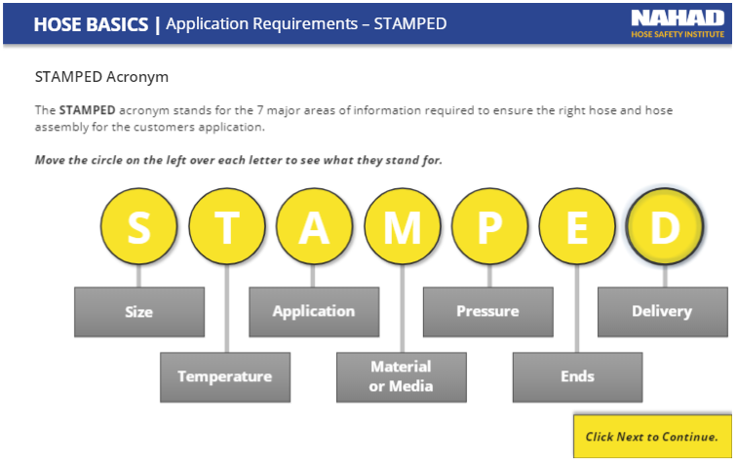
LEARNERS INTERACT
Interact with the content required

Slide 6
LEARNERS ARE ENGAGED
Activities are built into the course

Slide 7
KNOWLEDGE IS CHECKED
‘Knowledge Checks’ are added after each section

Slide 8
SUBSCRIPTION OPTION
Purchase Annual Subscriptions
A subscription provides one employee access to 200+ titles plus HSI Certification Courses
Track employee progress & completions
$295 per subscription

Slide 9
HSI CERTIFICATION SERIES OPTION
Register an Employee for NAHAD HSI Certification Series
Enrolled in and qualify for HSI certification in more than one hose type: Industrial, Hydraulic, Corrugated Metal or Composite Hose
$150 includes one hose type course
$ 50 for each additional hose specialty course

Slide 11
ENROLL TODAY
Go to: www.nahad.org/education
Email: education@nahad.org

