Slide 1

INTRODUCTION TO STAMPED

Slide 2
Mission
Primary educational program of NAHAD
Provides a forum for Distribution, Manufacturing, & End Users
Offers our members a roadmap for consistent, reliable and safe hose fabrication
Core deliverables – HSI Handbook and Fabrication Guides
Notes:
The Hose Safety Institute is a NAHAD educational program, formalized almost 20 years ago. This program provides a forum for Manufacturers, Distributors, end users and related organizations to discuss better ways to promote and drive hose assembly safety, quality and reliability. Through the HSI structure, NAHAD has been able to support industry collaboration, build consensus and establish minimum performance standards for hose assembly design, fabrication, and overall management. Most importantly, it offers our members a roadmap for consistent, reliable and safe hose fabrication.
The program has produced multiple publications based on the outcomes of this collaboration and consensus – the most significant of which are the HSI Handbook for the Design and Specification of Hose Assemblies and the NAHAD Hose Assembly Guidelines – commonly referred to as the HSI Fabrication Guides. Both of these publications contain the definition and details of adopted guidelines and best practices that support and complement existing industry and federal regulations.

Slide 3
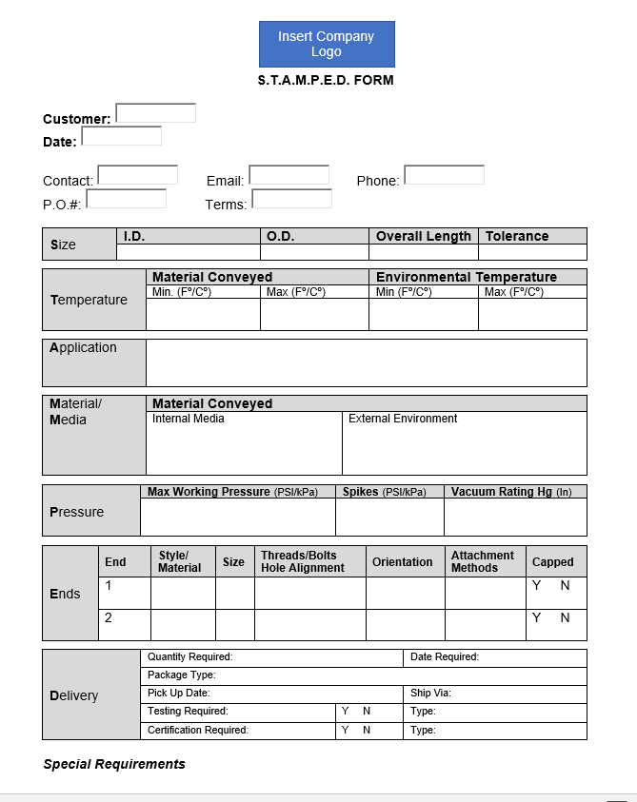
HSI Guidelines
Pre-Selection: STAMPED
S – Size
T – Temperature
A – Application
M – Media/Material
P – Pressure
E – Ends
D – Delivery

Slide 4
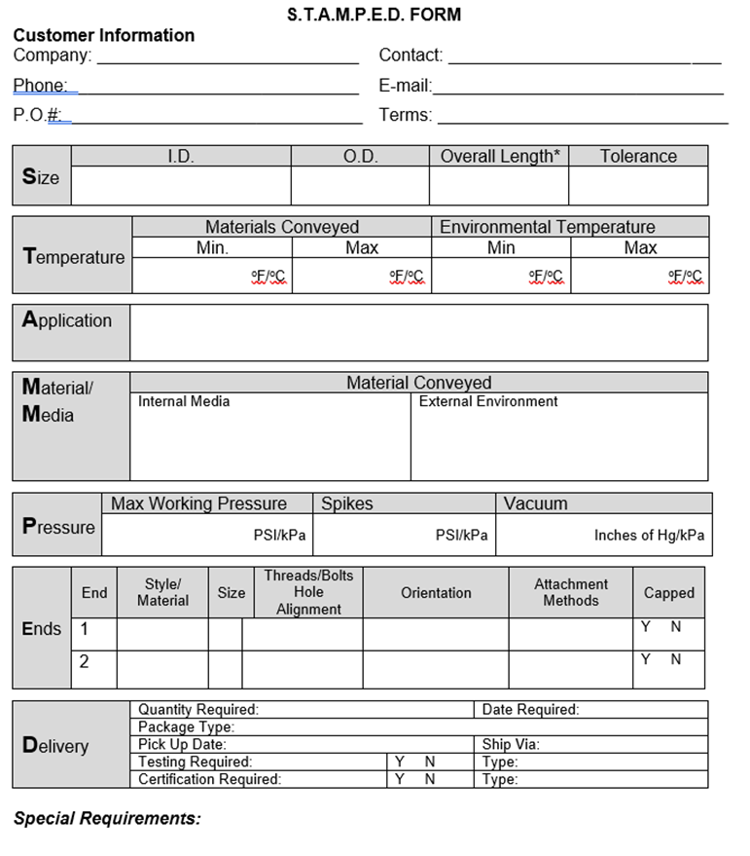
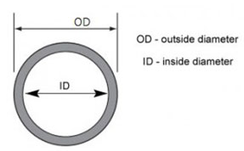
HSI Guidelines
S – Size
Inner Diameter
Outer Diameter constraints
Overall Hose Length w/fittings

Slide 5
HSI Guidelines
T – Temperature
What is the temperature
range of the material
conveyed through the hose;
What are the environmental
conditions under which the
hose will be used

Slide 6
HSI Guidelines
A – Application
What are the conditions of use:
configuration/routing,
intermittent or continuous
service,
indoor and outdoor use,
unusual mechanical loads,
excessive abrasion,
electrical conductivity requirements.

Slide 7
HSI Guidelines
M – Media/Material
What media/material is being
conveyed:
  Type (MSDS/SDS)
  Concentration
  Velocity
  Flow Rate
  Weight of Media
Proper liner material
Special hose cover requirements

Slide 8
HSI Guidelines
P – Pressure (PSI)
to which the assembly will be
exposed, including system
pressure, pressure spikes (highest
operating pressure) and vacuum
considerations
Specify pressure type:
Positive (psi)
Negative (InHg or inches wg)

Slide 9
HSI Guidelines
E – Ends
Fitting style & type
Orientation
  Requirement for unique angles
Proper attachment method
  Crimping
  Band clamps
  Field-attachable
Notes:
.

Slide 10
HSI Guidelines
D – Delivery
Special Requirements:
testing,
shipping,
packaging, or
tagging.

Slide 11
Questions about the Hose Safety Institute or STAMPED
https://nahad.org/about-the-institute/
education@nahad.org

